Slide 1


The Vegas Bandits
NBA Team Proposal
Jaden Mullin ● Evan Benham ● Muhammad Murtadha Ramadhan ● Firas Rasyid ● Calvin Huang

Slide 2
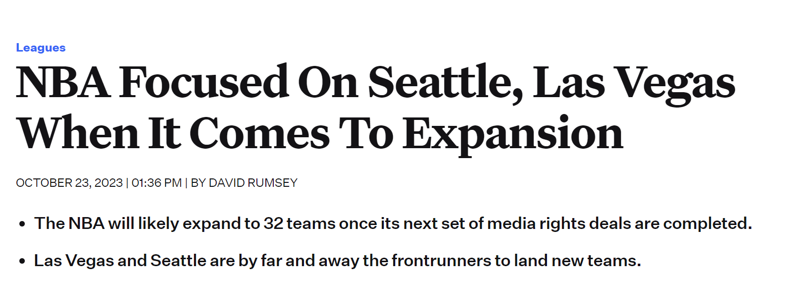
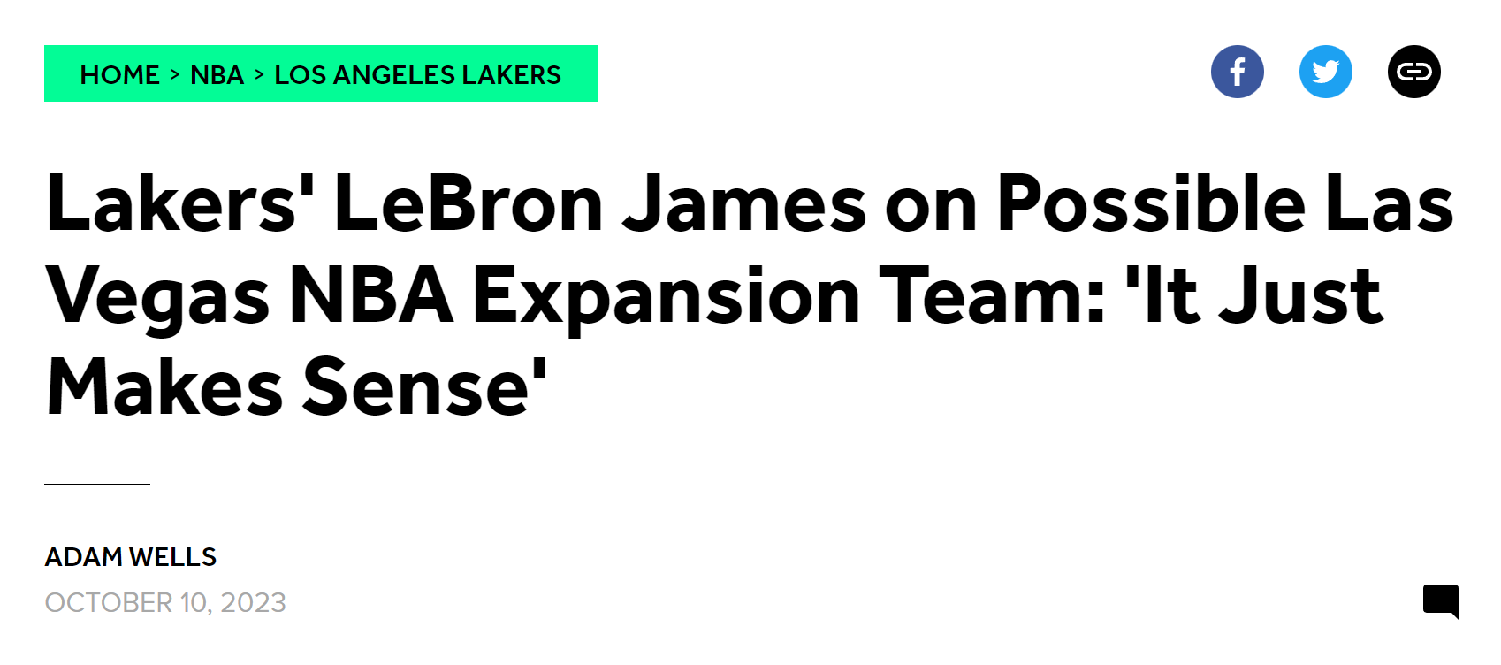
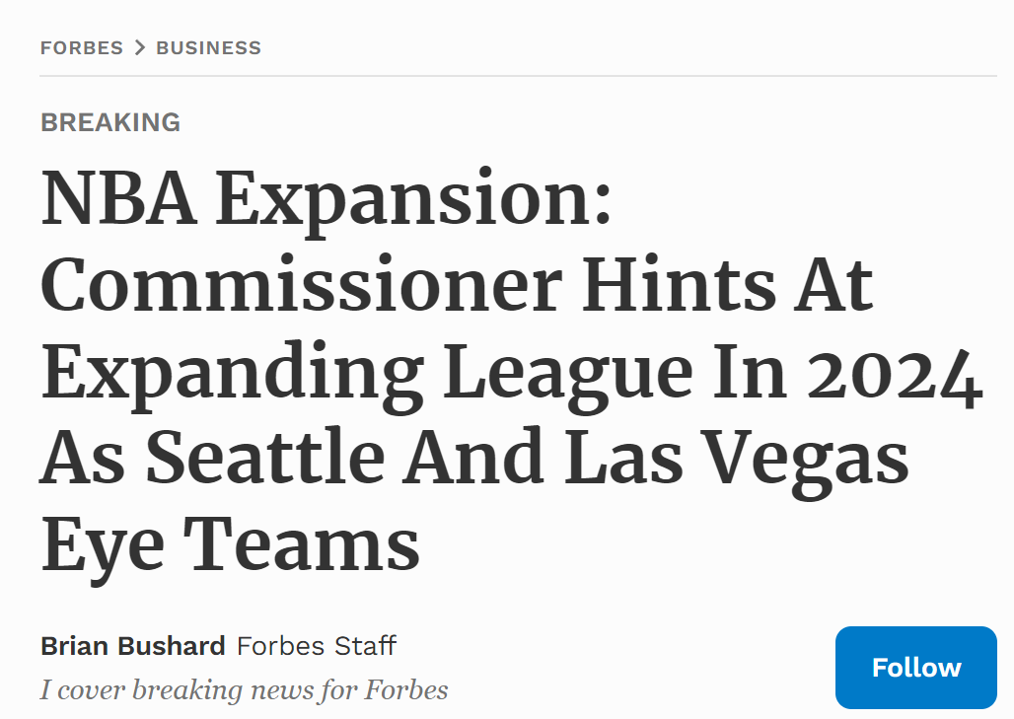
NBA is coming to Vegas, baby!

Slide 3


Business Question:
How do we select the roster to ensure on-court success?

Slide 4
Datasets
Team Standings
Individual Stats
Regular Season NBA team rankings based on win-loss record from 2022-2023 Season.
Source: Basketball Reference
Regular Season box scores and advanced stats of each player from 2022-2023 Season.
Source: Basketball Reference
Individual Salary
Players’ annual salary from 2022-2023 Season.
Source: Hoops Hype

Slide 5
Constraints
Limitations
Only using regular season data from 2022-2023 Season
Assume all players are available to procure
Only NBA players – no draft pickups
Budget limited to $123 million
Granularity of the data
Skew towards healthy players

Slide 6
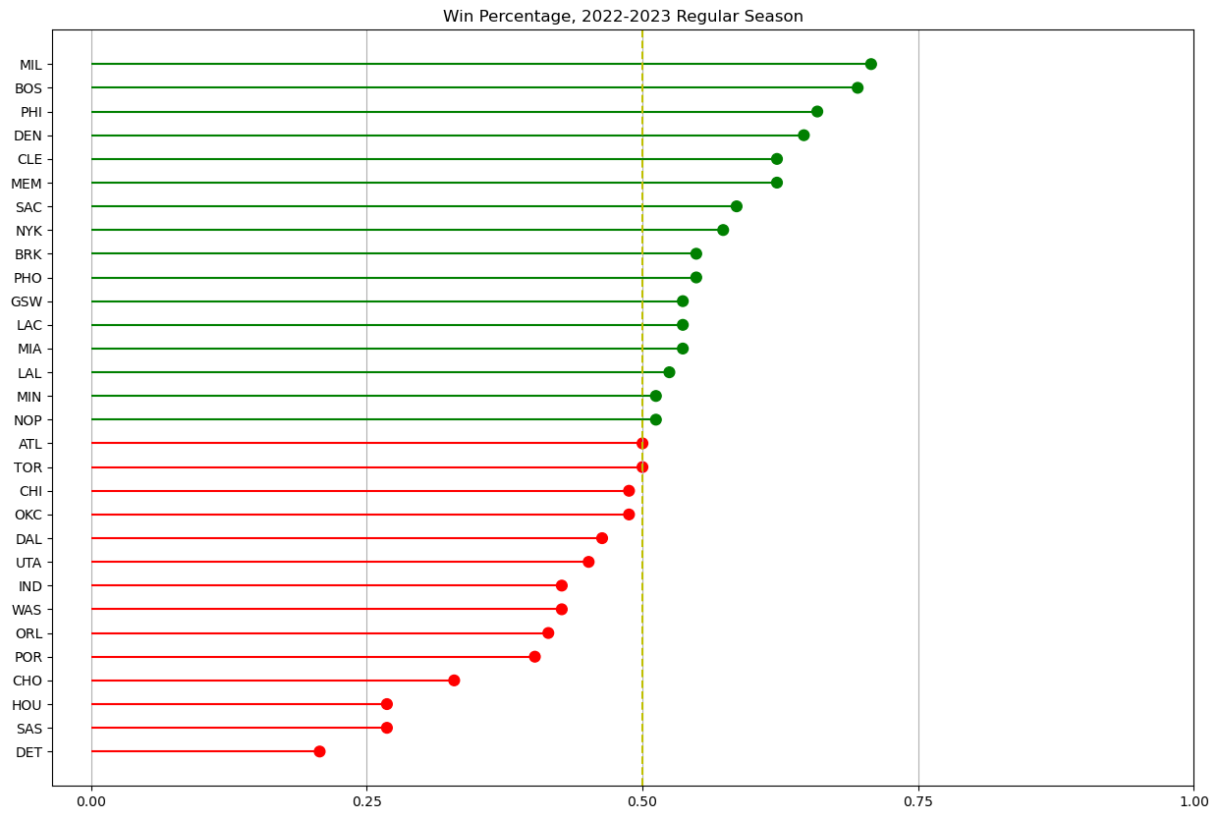

Descriptive Viz
Number of wins = Number of losses

Slide 7
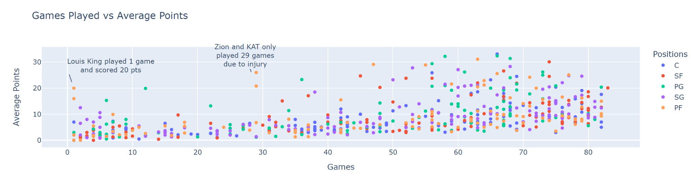
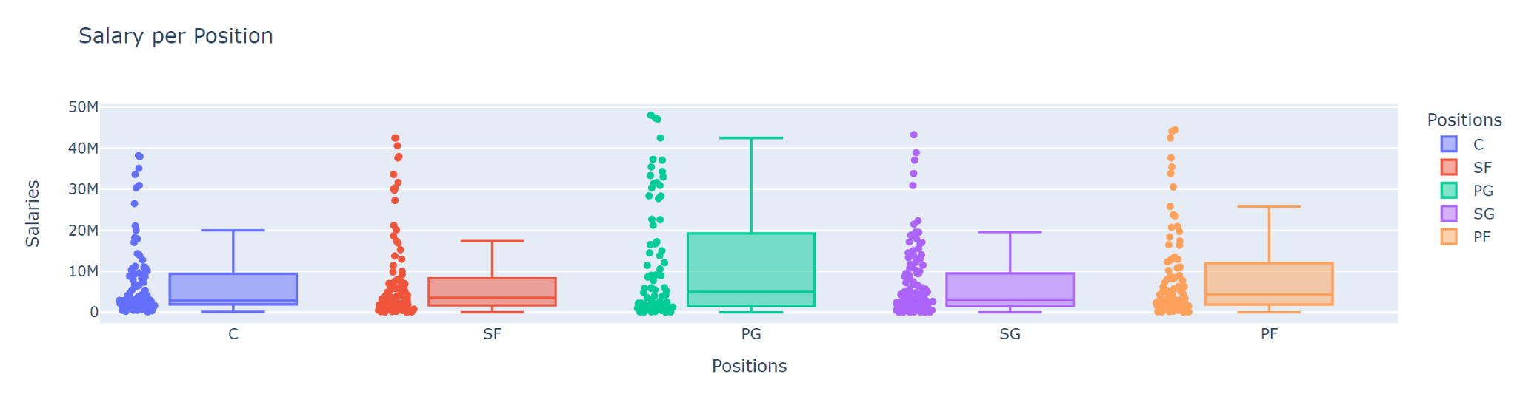

Slide 8
Two Strategies For Winning
Team Synergies
Individual Stats
Season wins
Championships
Team Statistics
Total Season Stats
Group by position

Slide 9

Test Design
Grouping
Impactful Players
Top vs Bottom
By position
Filtered out players by minutes played
Assumptions
Players apart of latest team
Players will hold latest position

Slide 10
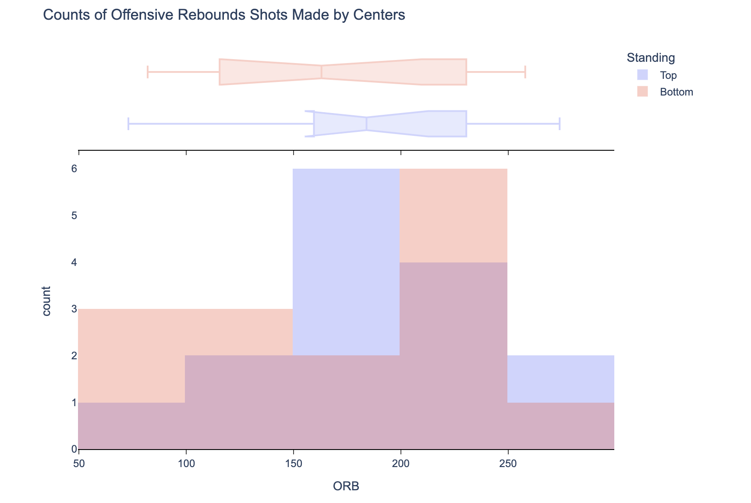
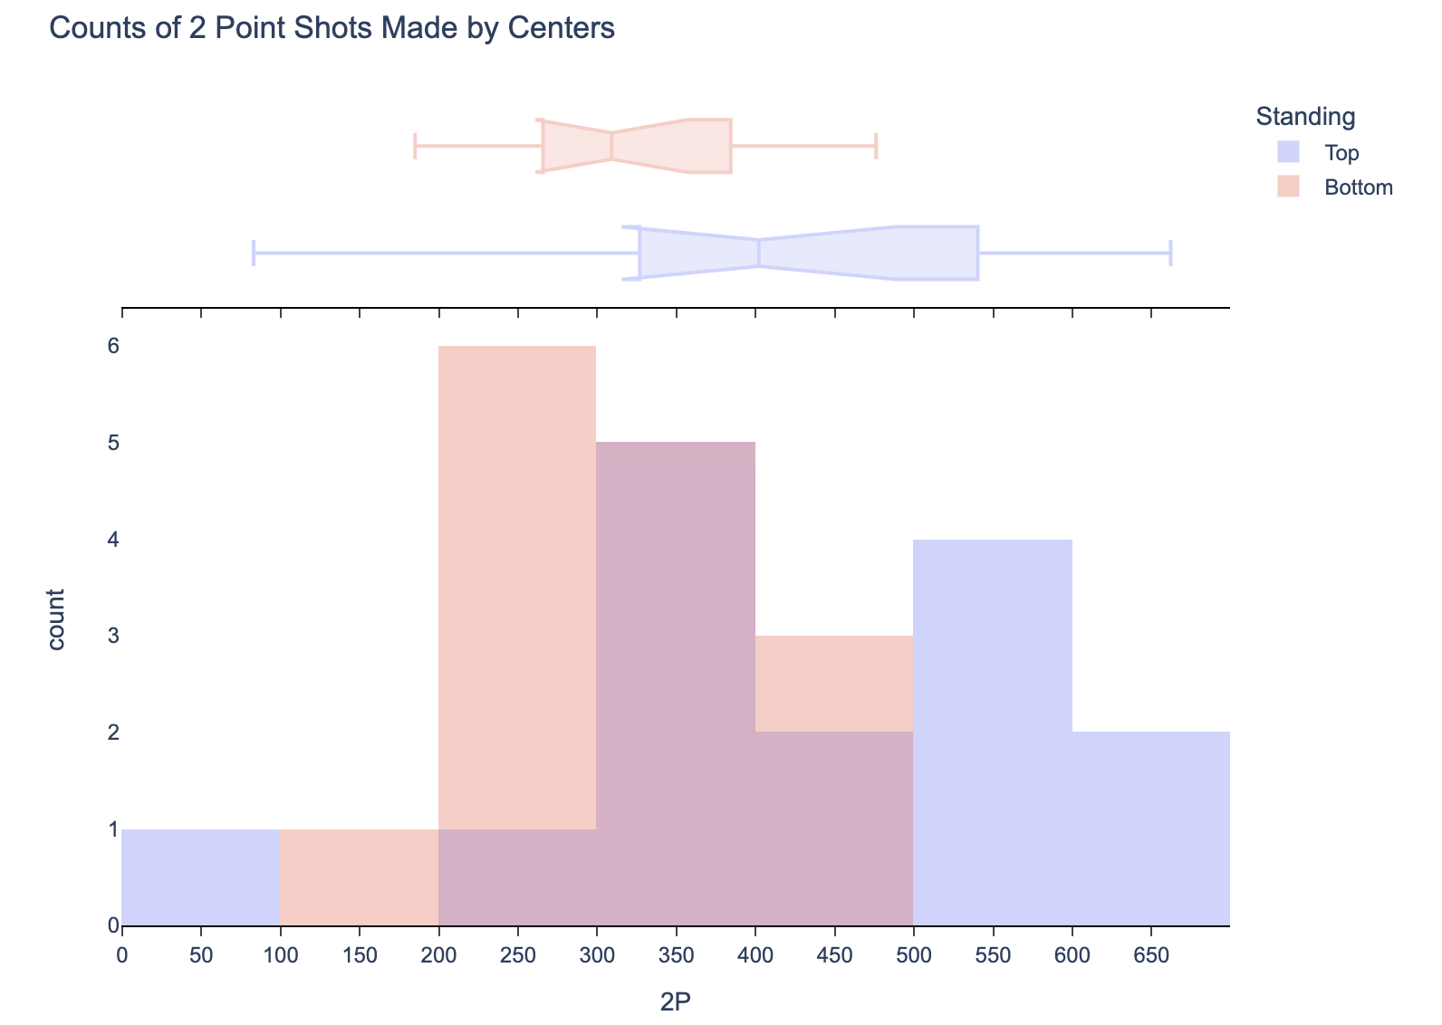

Testing
p = 0.5295
p = 0.0432

Slide 11
Winning Position Statistics
Point Guard
Shooting Guard
Small Forward
3P%
STL
3P
3P%
3PAr
TOV
ORB
DRB
TRB
Power Forward
Center
eFG%
TS%
DBPM
BPM
VORP
2P
BPM
DBPM
VORP

Slide 12
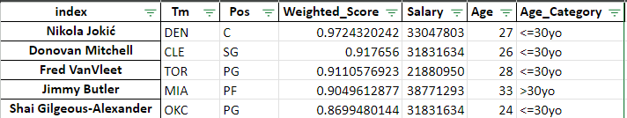
Weighting Stats & Ranking Players
Identify
2. Weighting
3. Normalize
4. Calculation
Which stats matter?
Deciding weights for each stat
Comparability between each stat
sum(Normalized Stat*weight)
5. Ranking
Highest Score = Best in their position

Slide 13
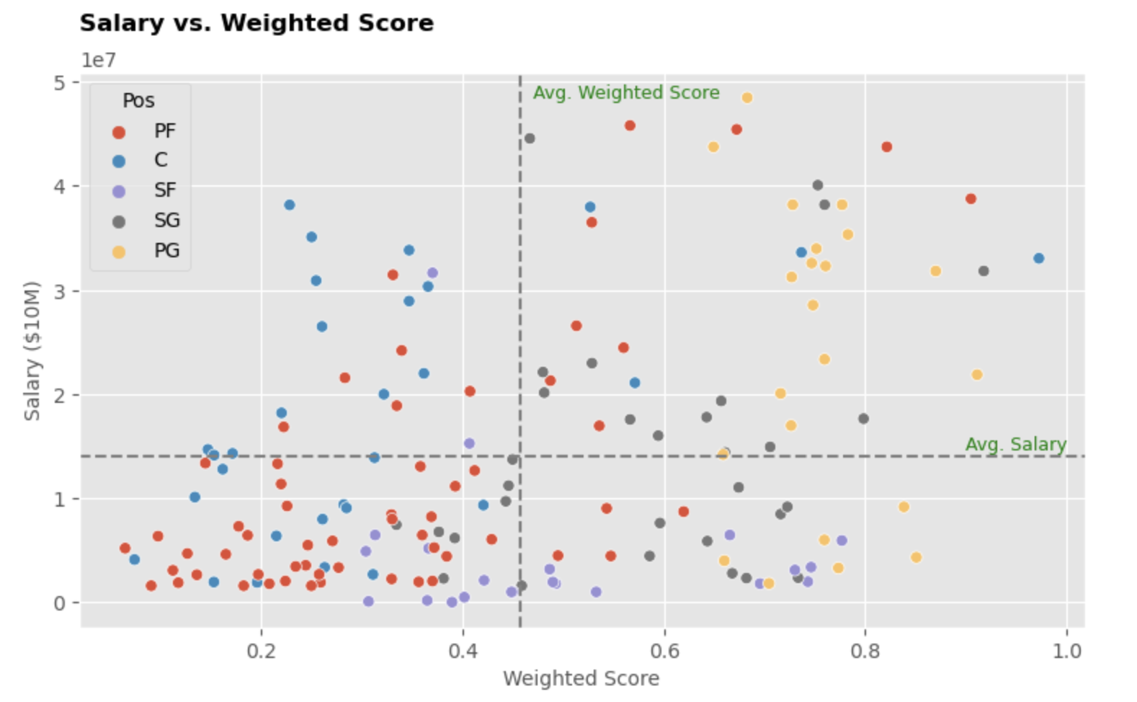
Potential Players
From all potential players with their calculated weighted score and salary data, we expect to hire players with high weighted score and cheap in salary

Slide 14
Player Selection with Linear Optimization
Decision Variables
Constraints
Which players to hire for each position
For each position, the total players that can be hired are 2 players
Total salaries for all players hired can’t exceed 123.655 million
Total salaries percentage for each position should be at most (of total salaries)¹:
PG: 23.10%
SG: 20.98%
SF: 21.47%
PF: 16.50%
Center: 17.96%
Maximum age is 30 y.o. for each player hired
Objectives
Maximizing the weighted score of players hired
¹https://www.samford.edu/sports-analytics/fans/2019/An-Analysis-of-NBA-Teams-Spending-by-Position-for-the-Upcoming-Season

Slide 15
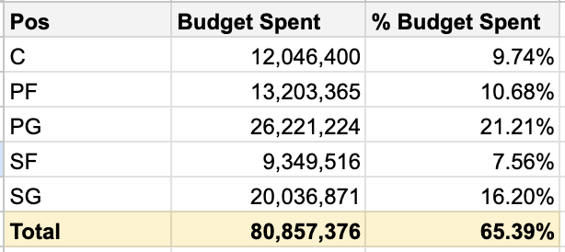
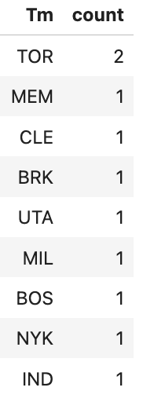
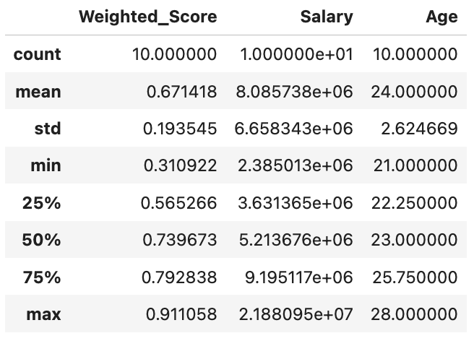
Selected Players in Stats
The overall players selected would only just use 65% of the total budget
Almost all players to hire are from different team except 2 players from Toronto Raptors
The average of weighted score is 0.671
The age of selected player is in the range of 21 y.o to 28 y.o

Slide 16
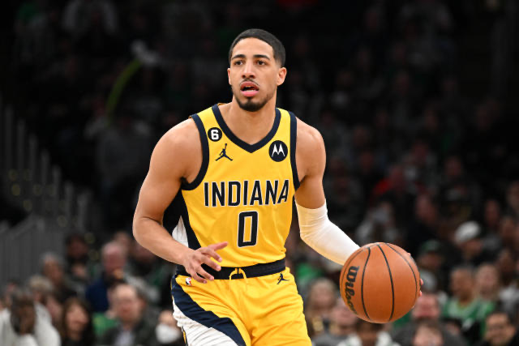
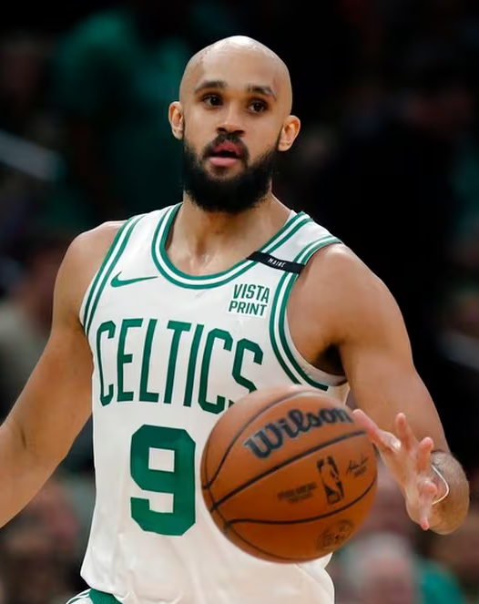
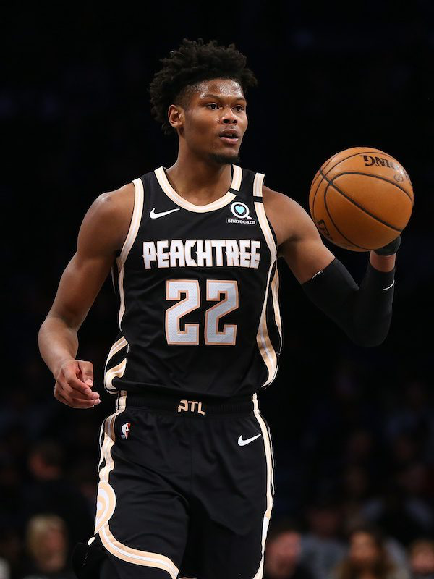
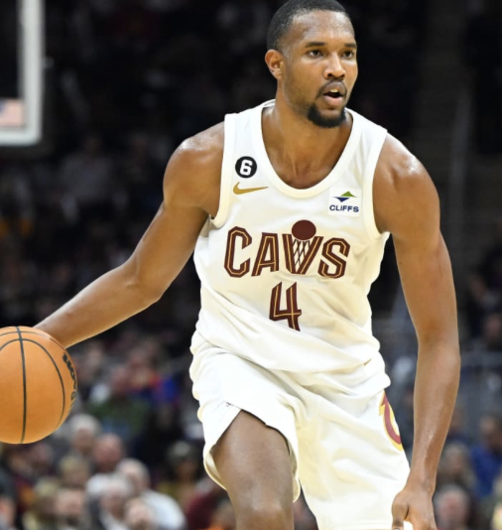
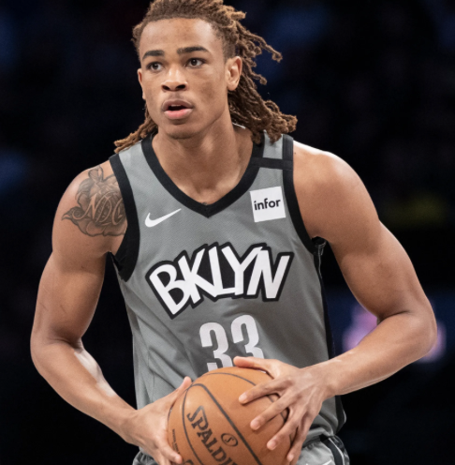

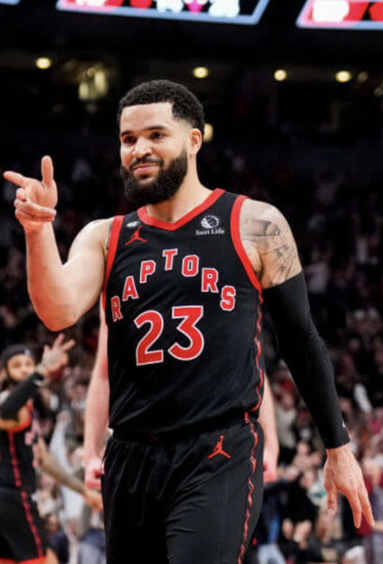
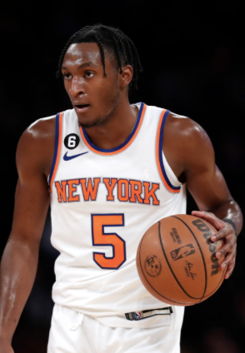
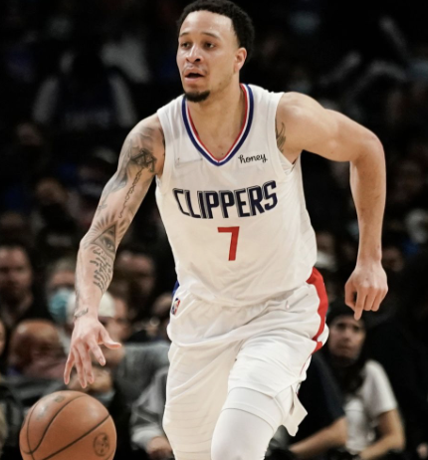
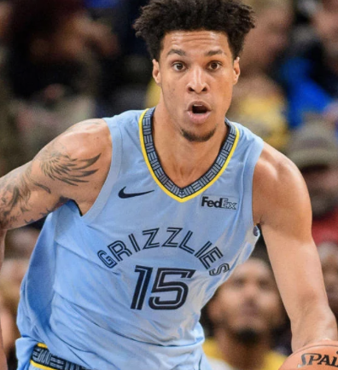
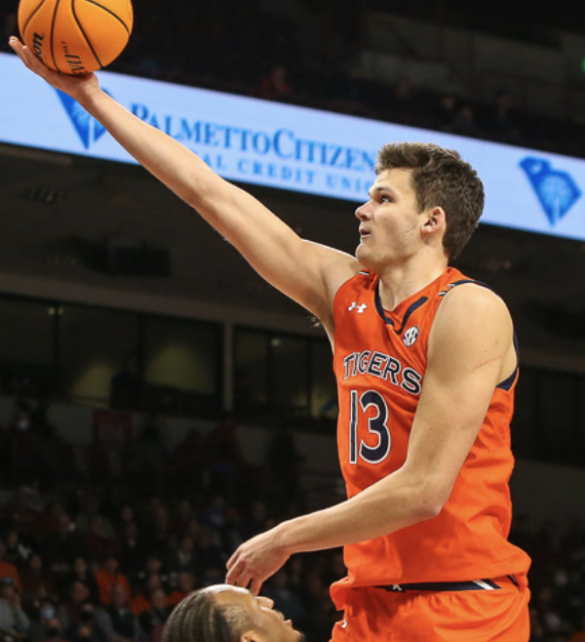
Our Team!
PG
SG
SF
PF
C
Tyrese Haliburton
Derrick White
Cam Reddish
Evan Mobley
Nic Claxton
Fred VanVleet
Immanuel Quickley
Amir Coffey
Brandon Clarke
Walker Kessler

Slide 17
What Did We Learn?
Some stats that we anticipated would be “statistically significant” weren’t — Why?
Statistically significant stats → how players on good teams distinguish themselves from players on bad teams to add more value to their team
Honing in on these stats at each position can impact a team’s ability to win more games

Slide 18
Thank You! Questions?

